Slide 1
Business Track
Nostalgia through Video Games
By: Ishan Rawat, Brenton Lian, Narasimha Cittarusu, Eziafa Ilabor

Slide 2
Theme
The overarching theme of the presentation was centered on finding popular video video through a variety of methods including total games produced, user ratings, critic rating and total sales. We developed visualizations for all decades combined as well as stratified them based on individual decades.

Slide 3
What software was used?
We used Pandas and Python for Data Cleaning and Excel for Data Visualization.

Slide 4
01
Which companies were popular throughout all 5 decades?

Slide 5
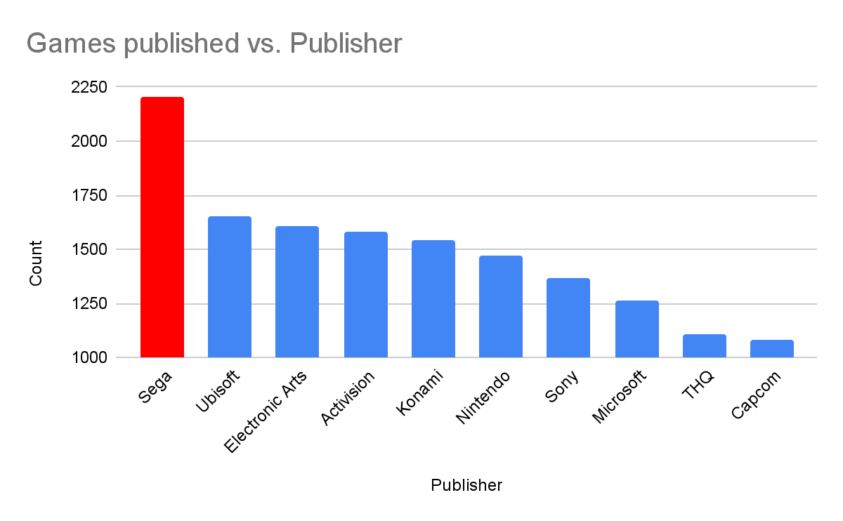
Holistic analysis of games produced.

Slide 6
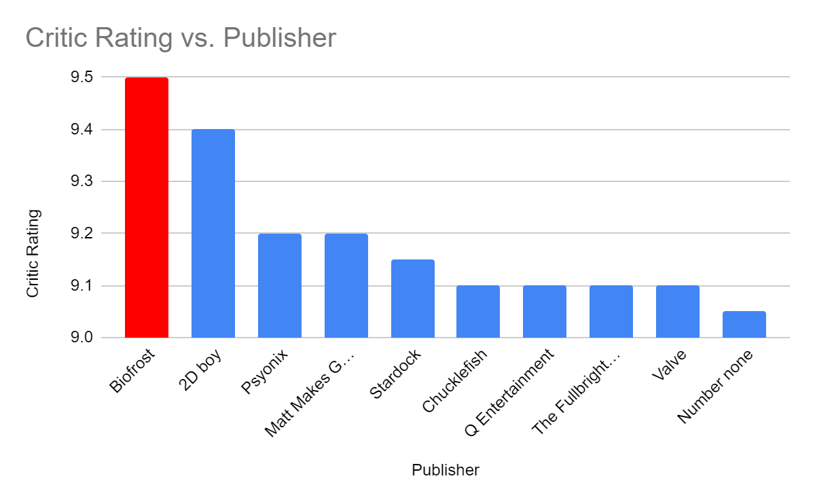
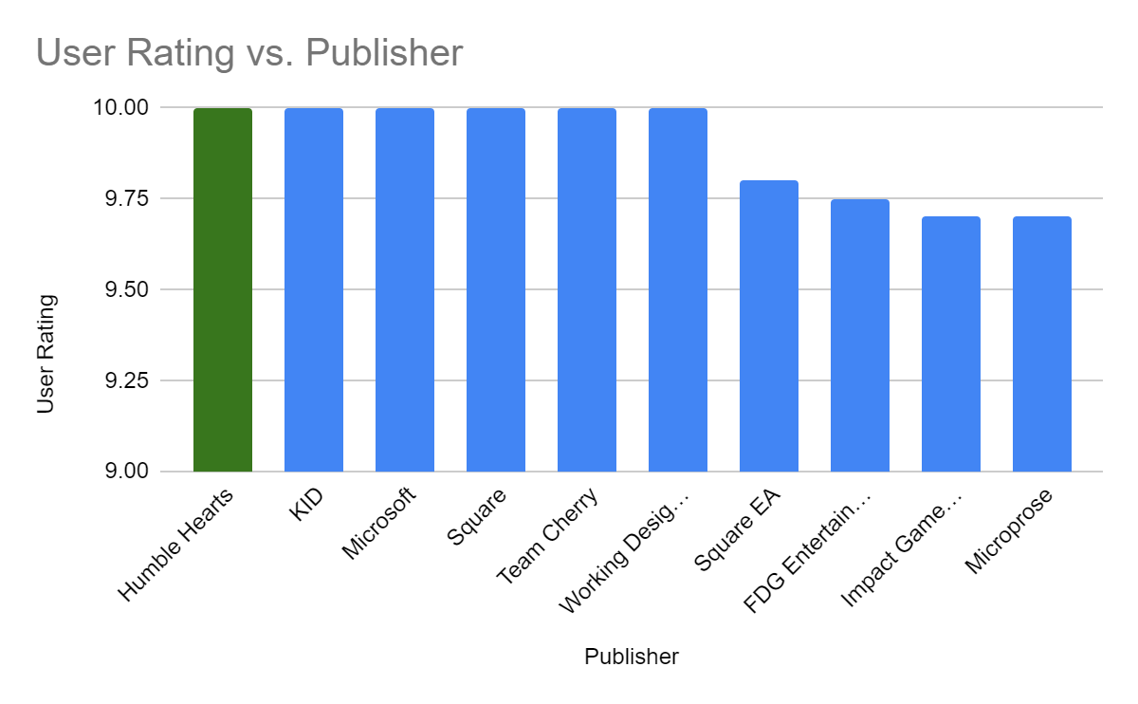
Average values of User vs Critic Analysis of the games

Slide 7
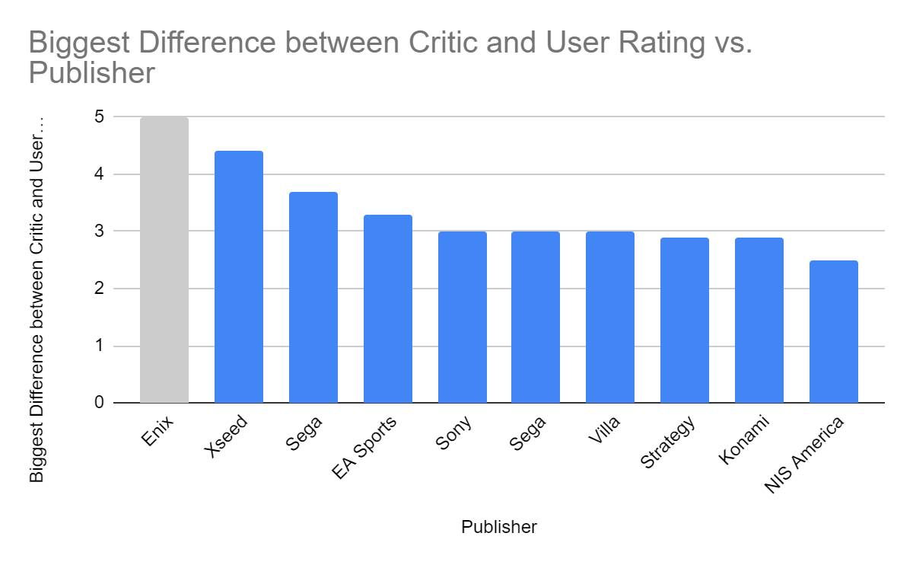
Biggest difference between Critic and User Rating (absolute value). These were the most controversial Publishers of all time.

Slide 8
02
Which game were popular decade by decade?

Slide 9
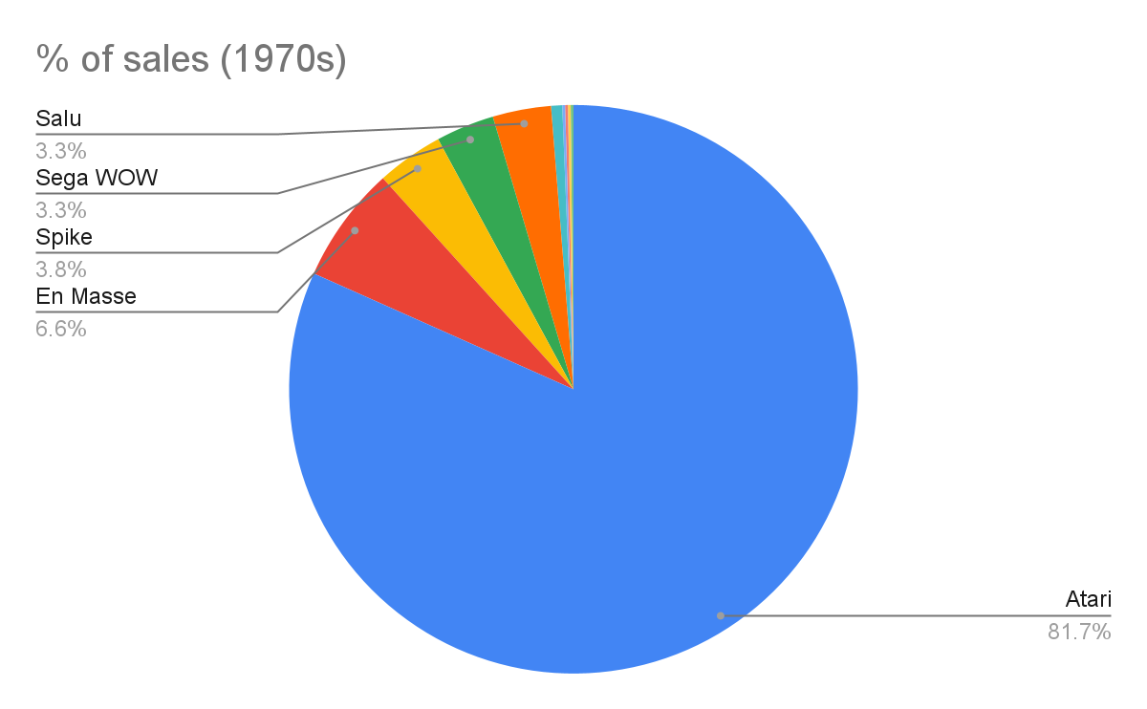
% of sales for top 10 games decade by decade and other games.

Slide 10
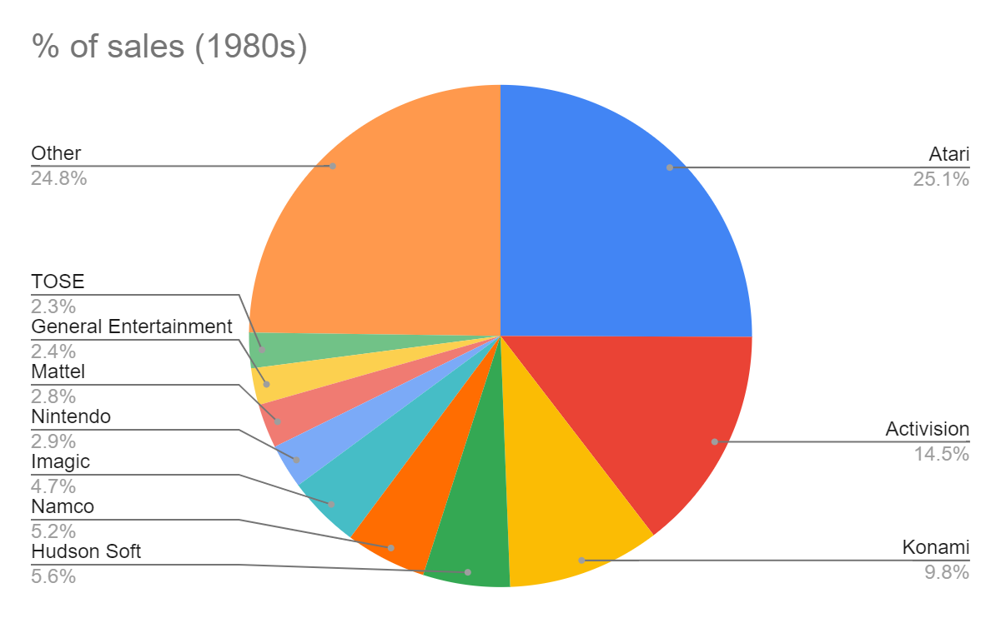

Slide 11
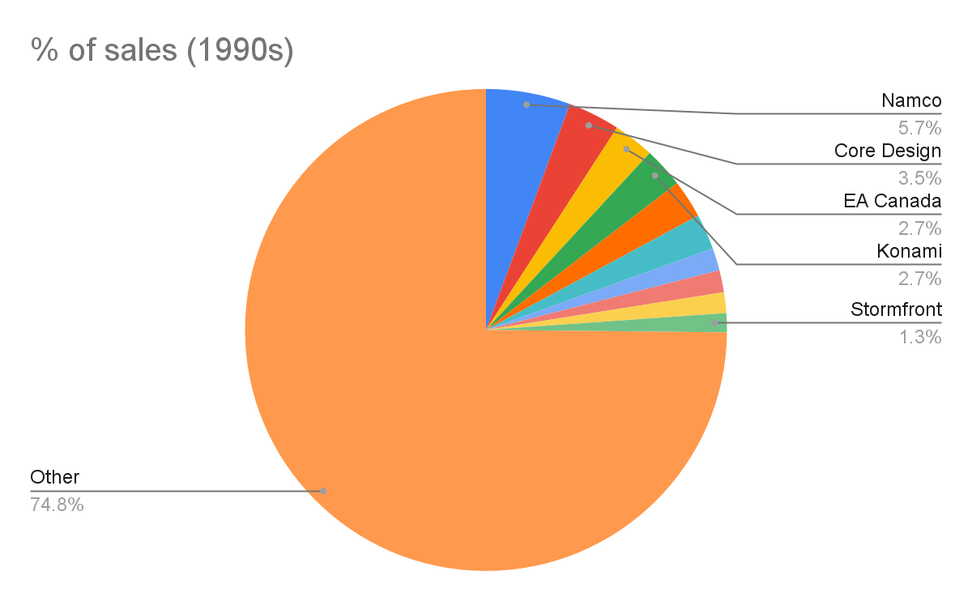

Slide 12
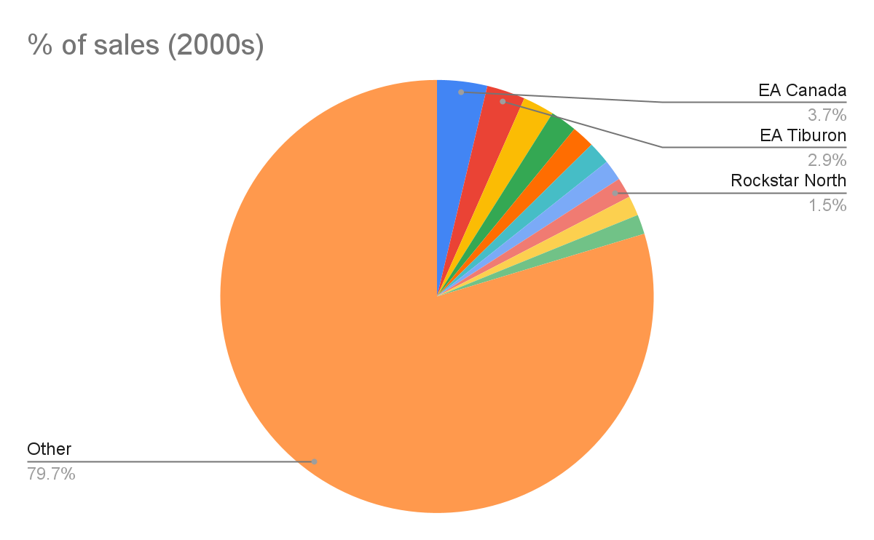

Slide 13
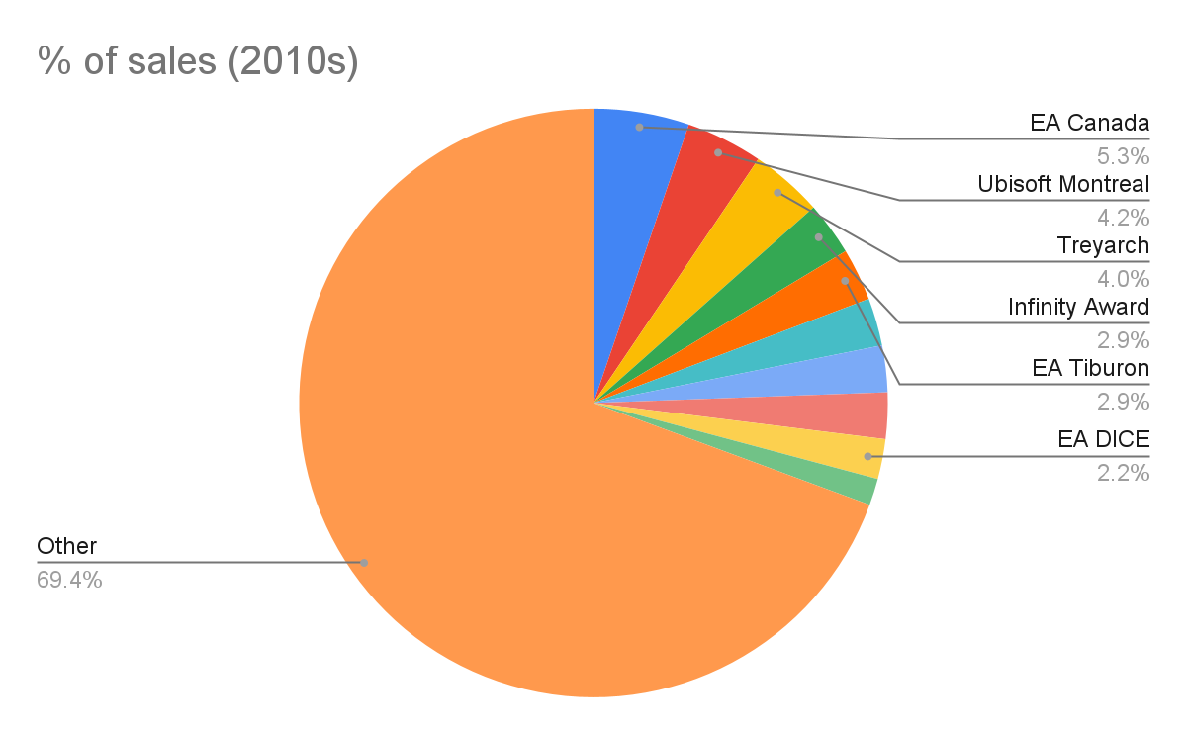

Slide 14
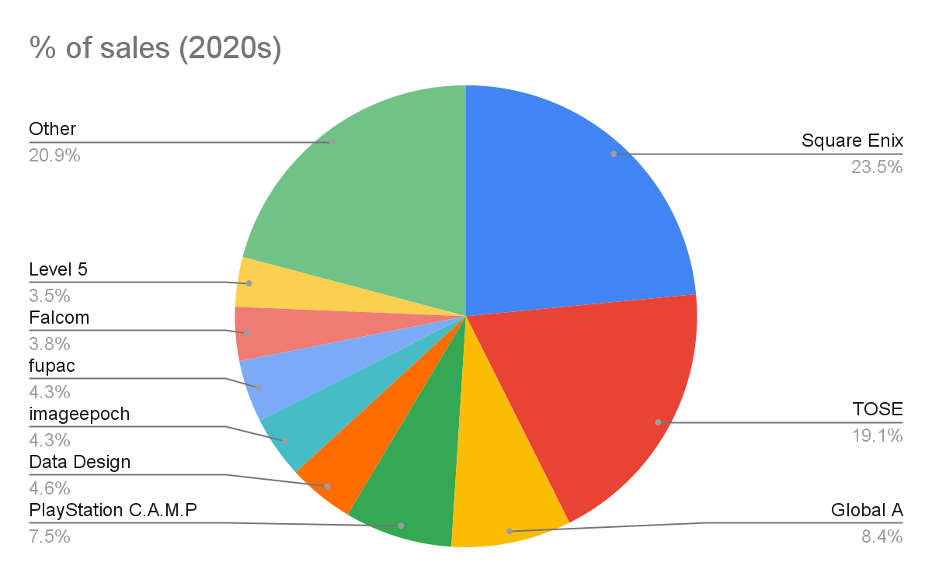

Slide 15
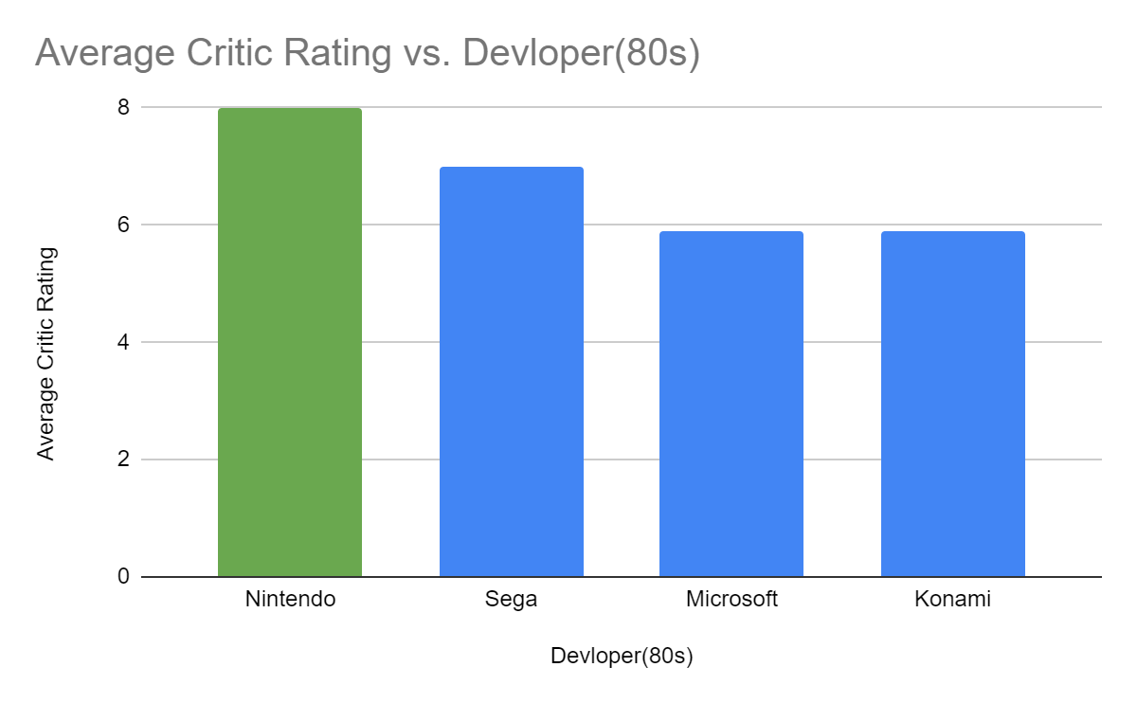
Average critic rating vs developer for each decade by decade.

Slide 16
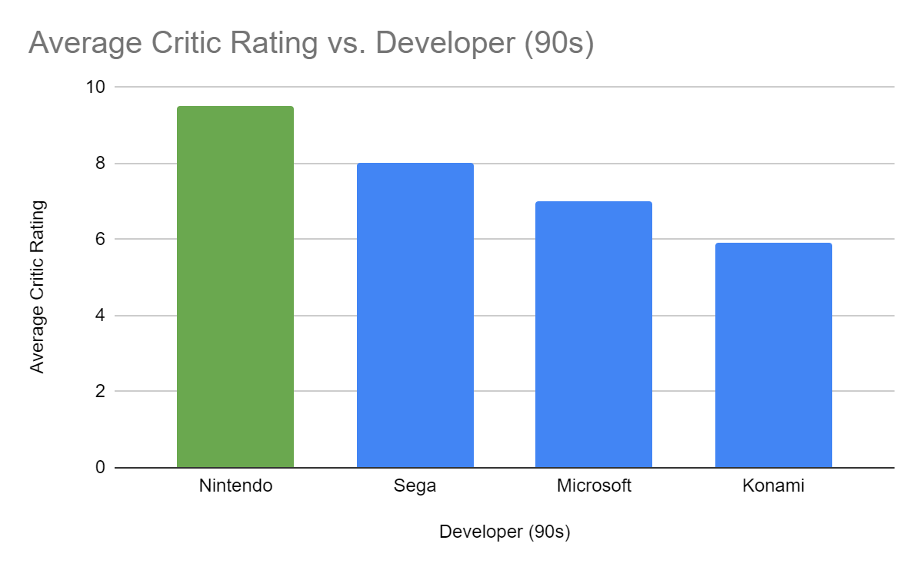

Slide 17
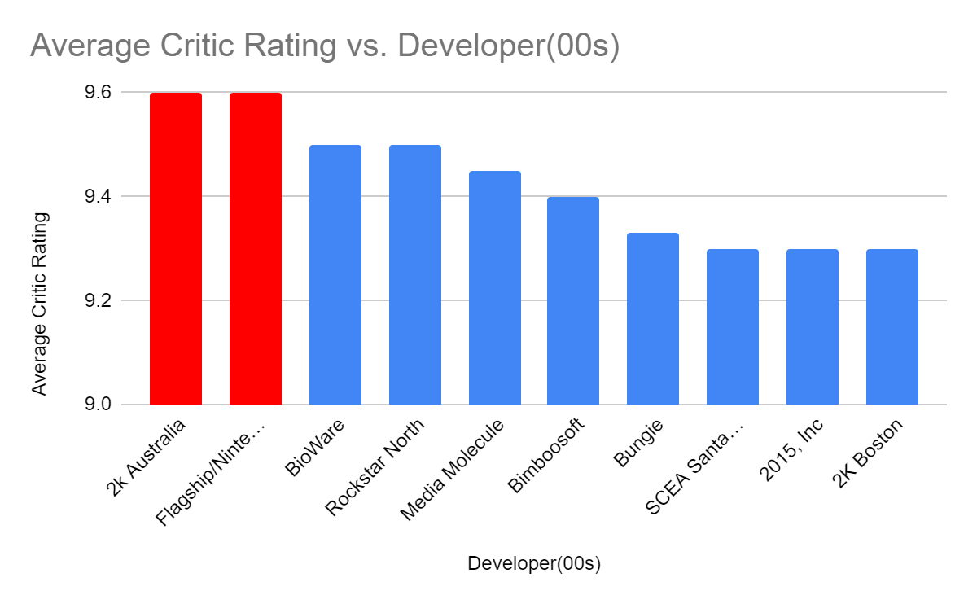

Slide 18
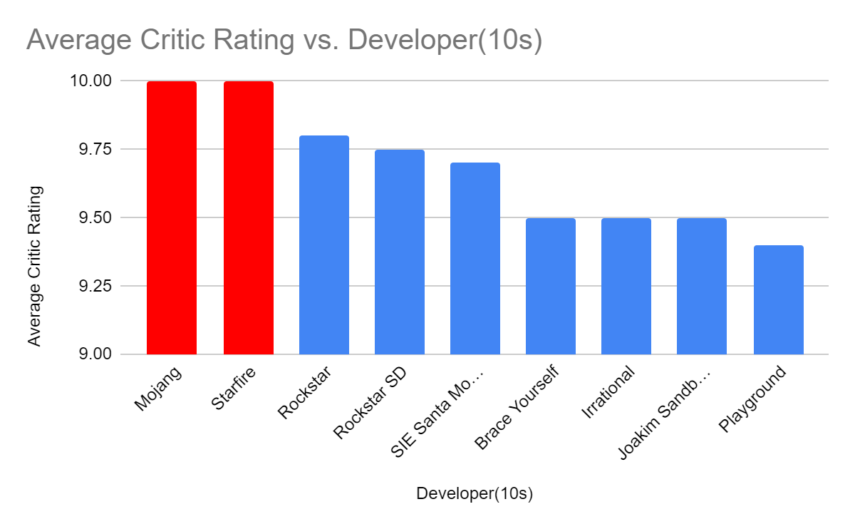

Slide 19
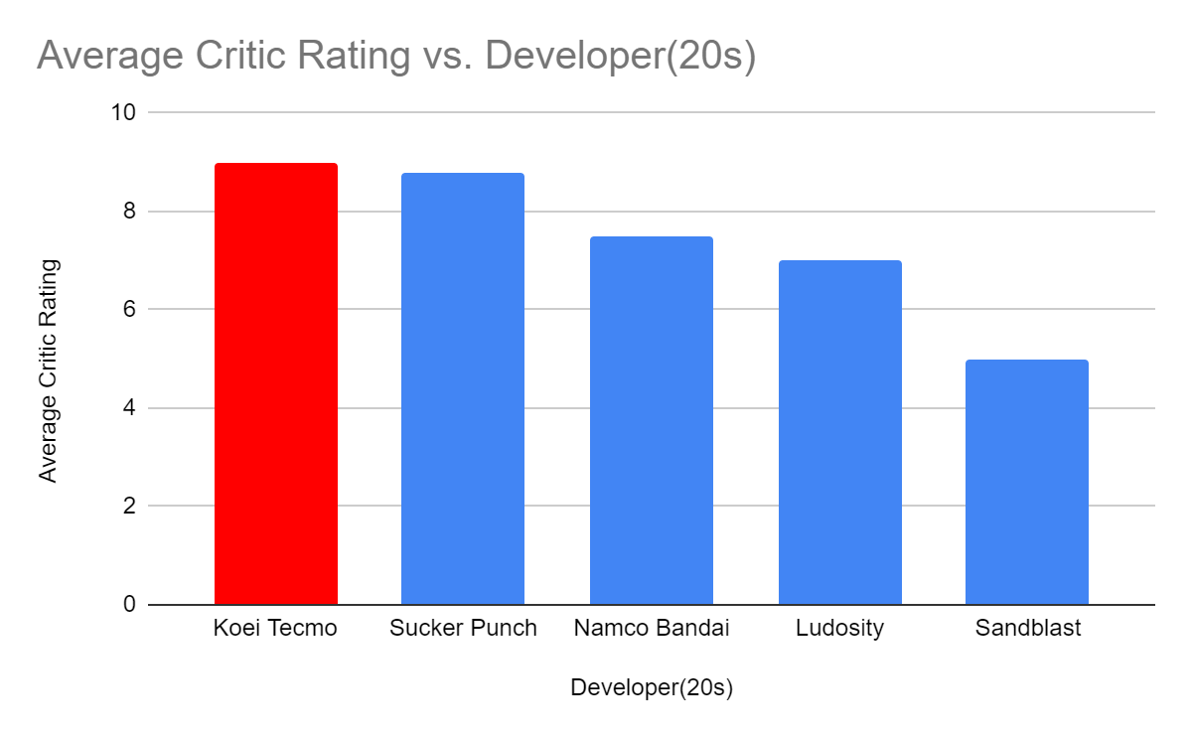

Slide 20
03
Success Between Companies

Slide 21
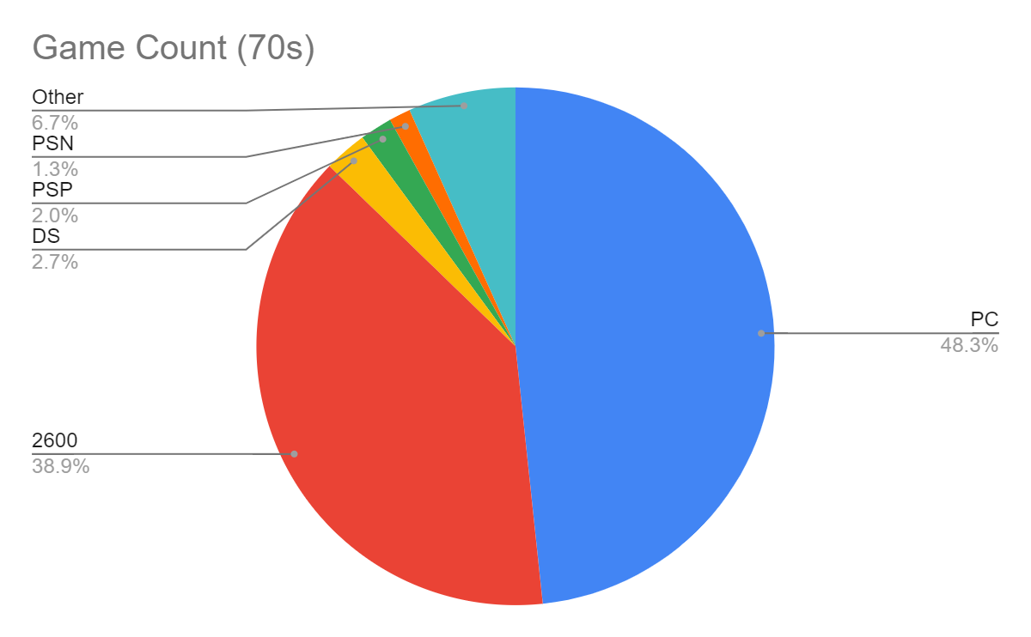
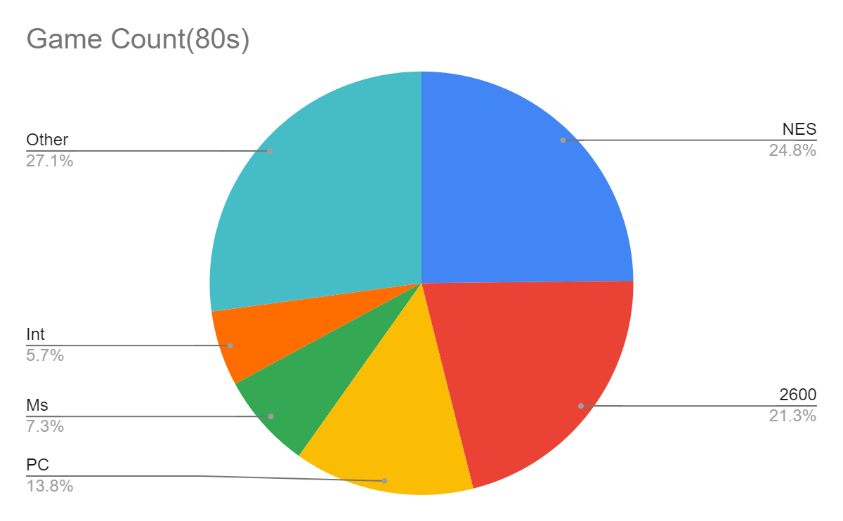
Percentage of Games by Console

Slide 22
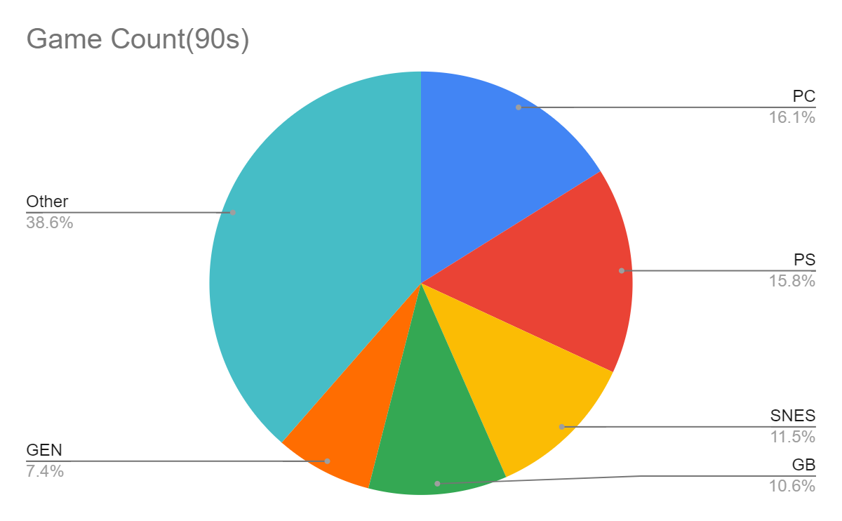
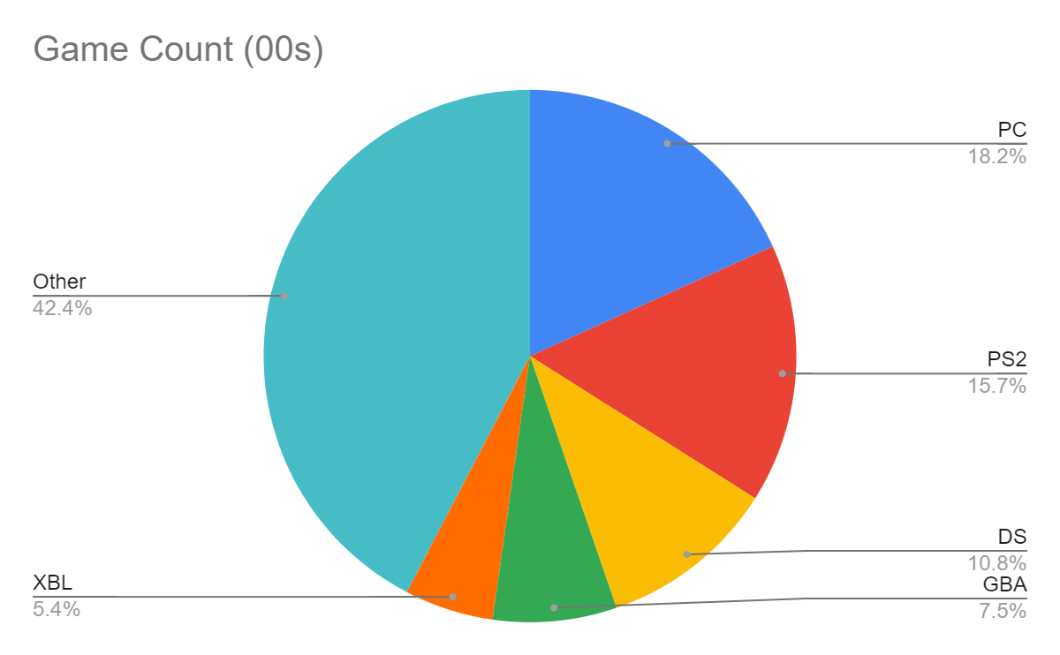
Percentage of Games by Console

Slide 23
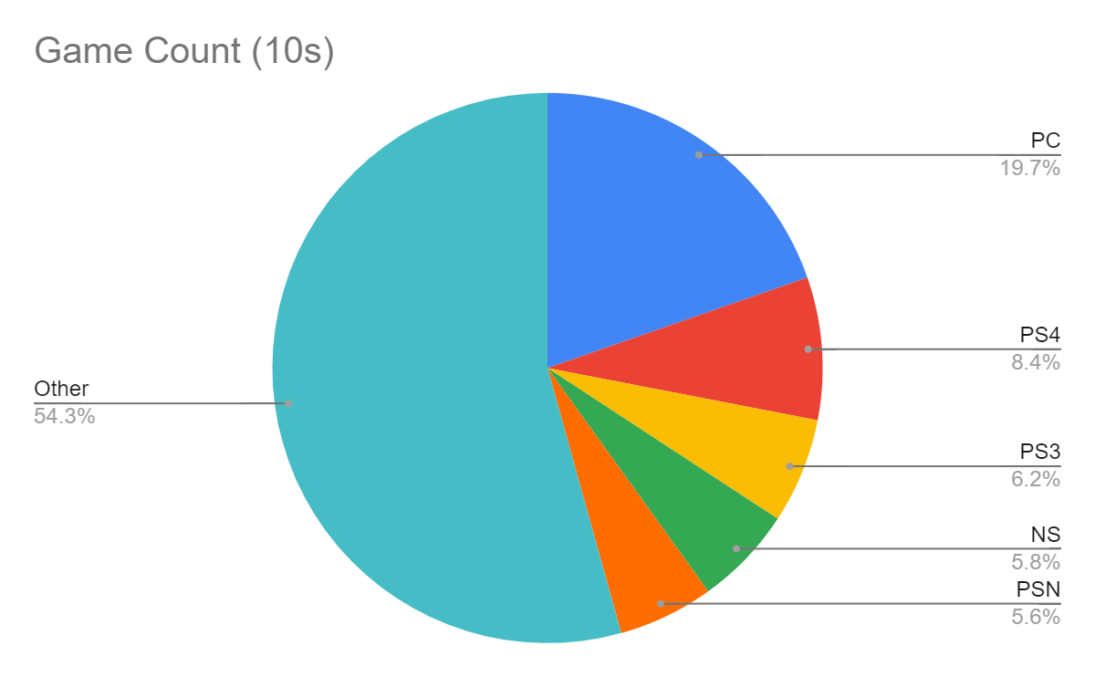
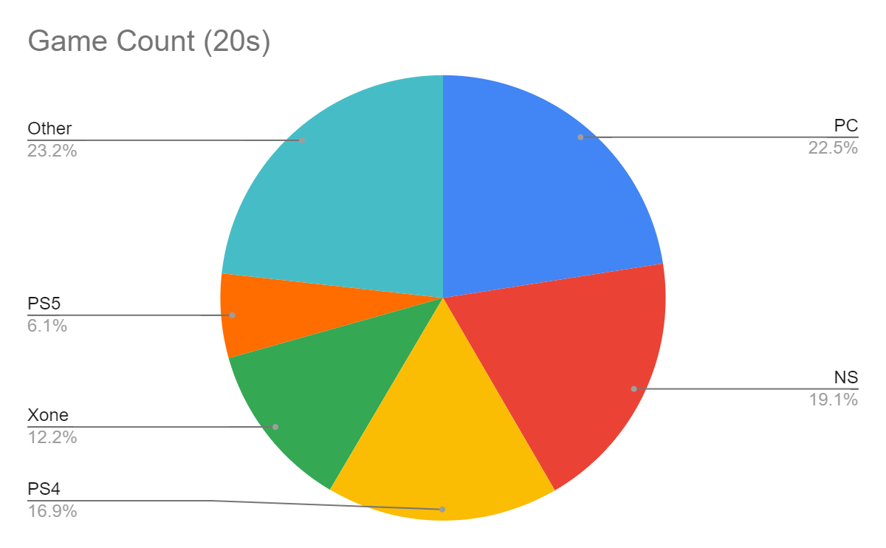
Percentage of Games by Console

Slide 24
04
Analysis

Slide 25
Conclusions (Developers)
Atari dominated the market of the 70s and 80s
Sega and Microsoft had good reviews thorough the 80s and 90s
Nintendo had good user and critic reviews over the entire analysis period
Rockstar had good reviews and sales after the 00s, and EA had good sales

Slide 26
Conclusions (Consoles)
The Atari 2600 was important in the 1970s and 80s
The NES and SNES were important in the 80s and 90s
The PC had large sales in the 70s, 90s, and 2000s, and 2010s
Playstation and Xbox series consoles became important after the 90s

Slide 27
Limitations
Lack of user and critic reviews
Incomplete data for 2020s
Lack of statistics for earlier decades

Slide 28
Questions
Sources
https://github.com/carolinadatascience/approaching-data-science-project/blob/main/Intro%20to%20Data%20Science%20-%20CDC%20Workshop.pdf

